Slide 1

Title IX Training
Indiana State University
August 21, 2020

Slide 2

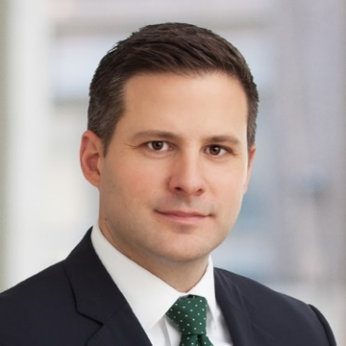


Today’s Speakers
Janilyn Daub
Partner – Employment
South Bend / Elkhart
janilyn.daub@btlaw.com
(574) 237-1139
Chris Bayh
Partner – Litigation
Indianapolis
chris.bayh@btlaw.com
(317) 231-7449
Mark Scudder
Of Counsel – Employment
Ft. Wayne
mark.scudder@btlaw.com
(260) 425-4618
Taylor Hunter
Associate – Employment
Indianapolis
taylor.hunter@btlaw.com
(317) 231-7755

Slide 3
ACKNOWLEDGMENT & DISCLAIMER
These materials were prepared by the attorneys at the law firm of Barnes & Thornburg LLP. These materials present general information about Indiana law and federal law, and they only serve as a beginning point for further investigation and study of the law relating to these topics. Although these materials present and discuss labor and employment law issues, they are not intended to provide legal advice. Legal advice may be given and relied upon only on the basis of specific facts presented by a client to an attorney. Barnes & Thornburg LLP and the authors of these materials hereby disclaim any liability which may result from reliance on the information contained in these materials.

Slide 4
Discussion Topics:
Title IX Overview
Regulatory Changes
Model Policy
Investigations
Hearings
Decisions & Appeals
Key Takeaways

Slide 5
Part I: Title IX Coordinators &
General Compliance

Slide 6
Title ix overview
Presented by Janilyn Daub & Taylor Hunter

Slide 7
What is Title IX?
Federal civil rights statute that prohibits sex discrimination, sexual
harassment, and retaliation in all aspects of the educational experience, including academics, extracurricular activities, and athletics
  Title IX of the Educational Amendments of 1972 to the Civil Rights Act of 1964
  “No person in the United States shall, on the basis of sex, be excluded from participation in, be denied the benefits of, or be subjected to discrimination under any education program or activity receiving federal financial assistance.”

Slide 8
Key Issues Covered by Title IX
Recruitment, admissions, and counseling
Financial assistance
Athletics
Sex-based Harassment
Pregnant and Parenting Students
Discipline
Single-Sex Education (schools, classes, and extracurricular activities)
Employment
Retaliation

Slide 9
Title IX Regulations
Title IX’s statutory language is brief.
Federal government has issued guidance clarifying how it interprets and enforces those regulations
    Obama 2011 and 2014 guidance
    Trump 2017 Interim guidance

Slide 10
DeVos revoked Obama-era guidance in
September 2017
Released Q&A “Interim Guidance”
  removed the preponderance of evidence standard as the appropriate standard of proof for investigating allegations of sexual violence;
  eliminated the 60-day timeframe from Title IX investigation proceedings;
  allowed an appeals process initiated either by both parties or solely by accused students; and
  created an informal resolution option

Slide 11
Guiding Principles
Rulemaking process rather than mere guidance
Greater clarity to ensure that all schools clearly understand their legal obligations under Title IX and that all students clearly understand their options and rights
Fair process for the accused

Slide 12
Proposed Regulations
Published November 16, 2018. (first Title IX guidance published by OCR to go through a formal notice-and-comment process since 1997)
Comments were taken until January 30, 2019 (appx. 124,000 comments)
Final regulations effective August 14, 2020
  Effect of Coronavirus?
Remember—the regulations are the law!

Slide 13
Timing Problems
  What about claims regarding events that occurred before August 14, but whose investigation hasn’t started?
  What if the investigation was started but is not completed by August 14th?
  What if a case has been resolved but an appeal is initiated after August 14^{th?}
Notes:
Meagan – I added this. I don’t have the answers.

Slide 14
Timing Problems
  What about claims regarding events that occurred before August 14, but whose investigation hasn’t started?
  What if the investigation was started but is not completed by August 14th?
  What if a case has been resolved but an appeal is initiated after August 14^{th?}
Notes:
Meagan – I added this. I don’t have the answers.

Slide 15
Timing Problems
  What about claims regarding events that occurred before August 14, but whose investigation hasn’t started?
  What if the investigation was started but is not completed by August 14th?
  What if a case has been resolved but an appeal is initiated after August 14^{th?}
Notes:
Meagan – I added this. I don’t have the answers.

Slide 16
Recent Clarification
  Does the Title IX Rule apply retroactively? No. OCR will enforce the Rule prospectively.
  The Rule does not apply to schools’ responses to sexual harassment that allegedly occurred prior to August 14, 2020. In other words, the Rule governs how schools must respond to sexual harassment that allegedly occurs on or after August 14, 2020.
  What about pending cases? OCR will judge the school’s Title IX compliance against the Title IX statute and the Title IX regulations in place at the time that the alleged sexual harassment occurred.
  “The Title IX Rule Is Effective on August 14, 2020, and Is Not Retroactive,” Office for Civil Rights Blog (Aug. 5, 2020) https://www2.ed.gov/about/offices/list/ocr/blog/20200805.html
Notes:
Meagan – I added this. I don’t have the answers.

Slide 17

Regulatory changes
Presented by Taylor Hunter

Slide 18
What’s New?
Mandatory Training
Roles (the same but different)
Sexual Harassment Definition
Scope of Coverage
Actual Knowledge
Grievance & Hearing Procedures
Retention of Records

Slide 19
Key Roles
Title IX Coordinator (must be an employee)
Investigator
Advisor (party permitted to have an advisor of his/her choice)
Decision-maker(s)
  Key Change: The Decision-maker cannot be the same person as the Title IX Coordinator or the Investigator.

Slide 20
Training Requirements
A [University] must ensure that Title IX Coordinators, investigators, decision-makers, and any person who facilitates an informal resolution process, receive training on the definition of sexual harassmentin §106.30, the scope of the recipient’s education program or activity, how to conduct an investigation and grievance process including hearings, appeals, and informal resolution processes, as applicable, and how to serve impartially, including by avoiding prejudgment of the facts at issue, conflicts of interest, and bias…A [University] also must ensure that investigators receive training on issues of relevance to create an investigative report that fairly summarizes relevant evidence, as set forth in paragraph (b)(5)(vii) of this section.

Slide 21
Training Requirements
Must train all Title IX personnel on:
  Key definitions.
  How to conduct investigations/grievance process.
  How to be impartial.
Must provide decision-makers and investigators with training on evidentiary issues.
  Relevancy.
  Rape shield protections.
Must train decision-makers on any technology using at hearings.

Slide 22
Sexual Harassment Definition
An employee of the recipient conditioning the provision of an aid, benefit, or service of the recipient on an individual’s participation in unwelcome sexual conduct;

Slide 23
Sexual Harassment Definition
An employee of the recipient conditioning the provision of an aid, benefit, or service of the recipient on an individual’s participation in unwelcome sexual conduct;
Unwelcome conduct determined by a reasonable person to be so severe, pervasive, and objectively offensive that it effectively denies a person equal access to the recipient’s education program or activity; or

Slide 24
Sexual Harassment Definition
An employee of the recipient conditioning the provision of an aid, benefit, or service of the recipient on an individual’s participation in unwelcome sexual conduct;
Unwelcome conduct determined by a reasonable person to be so severe, pervasive, and objectively offensive that it effectively denies a person equal access to the recipient’s education program or activity; or
“Sexual assault” as defined in 20 U.S.C.1092(f)(6)(A)(v), “dating violence” as defined in 34 U.S.C. 12291(a)(10), “domestic violence” as defined in 34 U.S.C. 12291(a)(8), or “stalking” as defined in 34 U.S.C. 12291(a)(30).

Slide 25


Let’s consider a few examples…
Sexual harassment?

Slide 26
Scope of Coverage
Covers sexual harassment occurring “in the school’s education program or activity, against a person in the United States.”
What is the school’s “education program or activity?”
  Locations, events, or circumstances over which the school exercised substantial control over both the respondent and the context in which the sexual harassment occurs.
  Specifically includes any building owned or controlled by a student organization that is officially recognized by a postsecondary institution.

Slide 27
Who can report?
Any person may report sex discrimination, including sexual harassment (whether or not the person reporting is the person alleged to be the victim of conduct that could constitute sex discrimination or sexual harassment).
How?
    In person, by mail, by telephone, or by electronic mail, using the contract information listed for the Title IX Coordinator, or by any other means that results in the Title IX Coordinator receiving the person’s verbal or written report.
When?
At any time (including during non-business hours)

Slide 28
When does a university have an obligation to respond?
“Actual knowledge” means notice of sexual harassment or allegations of sexual harassment

Slide 29
Actual Knowledge – Who?
Title IX Coordinator, AND
A designated school official
  Must have authority to institute corrective measures on the school’s behalf
Is anyone a mandatory reporter?

Slide 30

Grievance Procedure:
Pre-Investigation
Presented by Mark Scudder

Slide 31
Pre-Investigation Topics
Filing of Formal Complaint
Mandatory Supportive Measures
Non-Retaliation Provisions
Dismissals
Informal Resolution Process
Notes:
Signpost Slide

Slide 32
Formal Complaints
Anyone can make a report of harassment
The grievance procedure is triggered by a Formal Complaint
Formal Complaints can be filed by:
  The Complainant (the aggrieved party), or
  The Title IX Coordinator

Slide 33
How must the school respond?
The school can’t be “deliberately indifferent” to the knowledge
The Title IX Coordinator must provide the following information to the individual:
  Availability of supportive measures;
  The right to file a complaint; and
  How to file a complaint

Slide 34
Respondent Notice
The Title IX coordinator must provide written notice to the respondent including:
  Actual allegations of facts that constitute sexual harassment and evidence that supports this
  That there is a presumption of innocence
  That parties are entitled to advisor of their choice
  That parties can inspect and review evidence
  Information regarding any code of conduct provisions that prohibit false statements

Slide 35
Respondent Notice
Certain actions can be taken with regard to the respondent for the duration of the investigation
  Can be put on administrative leave if they are an employee
  Can be removed from educational activities subject to emergency removal procedures – §106.44(c)
    Conduct an individualized safety and risk analysis which determines respondent poses an imminent threat to the physical health or safety of anyone which arises from the allegations of sexual harassment
    Respondent is given the chance to challenge removal immediately
Notes:
I think this is new.

Slide 36

Does This Situation Justify an Emergency Removal?
The weekend offender strikes again…

Slide 37
Supportive Measures
When a school learns of sexual harassment, its mandatory response must include an offer of supportive measures for both parties.
The Title IX Coordinator should promptly contact the parties to discuss the availability of supportive measures, consider the party’s wishes with respect to supportive measures, etc.
Supportive measures must remain as confidential as possible.

Slide 38
What are examples of supportive measures a University could offer?
Notes:
Examples:
Biased for or against an individual
Biased in the beliefs – such as the gender of the bad actor
Biased in believed staff over students
Biased based on any race, sex, religious belief, political belief, etc.

Slide 39
Supportive Measures
Free, individualized services designed to restore or preserve equal access to education, protect safety, or deter sexual harassment
  Support a student – not punitive or disciplinary with respect to another student
Does NOT need to be a formal complaint
Don’t unreasonably burden any other person
What about supportive measures for a non-student?

Slide 40
Non-Retaliation Provision
Any person retaliated against can file a complaint with the school and the school must have a procedures in place for the prompt and equitable resolution of those complaints
Any situation that could “chill” the bringing of Title IX violations can qualify as retaliation
Regulations provide that protected speech under the First Amendment never constitutes retaliation.

Slide 41

Is this retaliation?
A complainant reports a sexual assault that happened while under the influence of alcohol at a party and is punished for underage drinking – a code of conduct violation.
Notes:
A complainant reports a sexual assault that happened while under the influence of alcohol at a party. The complainant is then punished for underage drinking – a code of conduct violation.

Slide 42
Dismissals
Two types
  Mandatory dismissals
  Discretionary dismissals
For both types, notice must be promptly sent to all parties

Slide 43
Mandatory Dismissals
Alleged actions fail to meet definition of sexual harassment
Alleged actions did not occur “in the school’s education program or activity, against a person in the United States.”
These types of claims can still be addressed under their Code of Conduct – they are just not Title IX violations!

Slide 44
Discretionary Dismissals
If the complainant notifies Title IX Coordinator in writing that they wish to withdraw some or all of their allegations
If respondent is no longer enrolled or employed by school
If specific circumstances prevent school from gathering sufficient evidence to reach a determination about allegations

Slide 45
Informal Resolution Process
Requires voluntary and written consent from both parties
  Can not be a condition of employment or enrollment
Unavailable if respondent is an employee (including faculty) of the school
May take any form, but the school must must provide a facilitator who
  is free from conflicts of interest or bias
  has received special training
Either party may abandon the informal resolution process “at any time” and proceed the investigation and hearing process
Notes:
This is all NEW
Also certain notice requirements:
School still must provide all parties: of notice, rights, information of if the process is confidential and about withdrawing from the process and resuming the grievance process as per normal.

Slide 46
Key Takeaways
    No longer a safe harbor, now required by law
    Only if actual knowledge in a controlled area in the US.
    Redefine sexual harassment (severe and pervasive)
    Lower evidentiary standard
    Increase due process protections for the accused.
      Investigations—notice requirements and evidence sharing
      Hearings—with cross-examination
    Enlarge Title IX department
      No single investigator
      No conflicts

Slide 47

COMPLIANCE & Policy Considerations
Presented by Chris Bayh

Slide 48
Consequences of Potential Noncompliance
Department of Education Office of Civil Rights
Potential steps
  Complaint
  Investigation
  Enforcement action
Publication

Slide 49
Consequences of Potential Noncompliance
Civil suit
  Private right of action
Relations: campus, alumni, community, public

Slide 50
Other Impacts and Considerations
Law enforcement
  Campus police
  Local law enforcement
Privacy and protection
  FERPA
  Privilege
  Public records

Slide 51
Policy Considerations
Where do you want your university to come down on certain issues?
  How difficult will it be to prove sexual harassment
  How far will the policy spread
  Will your policy encourage or discourage filing complaints in unintentional ways
What are consequences of these choices from a marketing or outreach perspective?

Slide 52
Model policy
Presented by Taylor Hunter and Mark Scudder

Slide 53
Policy Requirements
There are limited regulatory requirements…
Who must receive notice of the policy
Where the policy must be published

Slide 54
Who must receive notice of the policy?
Students (current and applicants)
Employees (current and applicants)
Unions or Professional Organizations

Slide 55
What must they receive?
Contact information of the Title IX Coordinator
Notice of Non-Discrimination which includes:
  Statement that policy applies to both admissions and employment
  Where to address questions

Slide 56
Where does the policy need to be published?
Non-Discrimination policy must be published:
On the school website
In each school handbook or catalog

Slide 57
…and then comes the grievance process.
The regulations are much more explicit about what needs to be included in the policy regarding the grievance process!

Slide 58
Grievance Process
The policy must include information on how to report or file
The Grievance Process must include:
  Standard of Evidence
  Presumption of Innocence
  “Reasonably prompt time frames”
  Range of sanctions
  Procedures and permissible bases to appeal
  Range of supportive measures available to each side

Slide 59
The Model policy

Slide 60
Model Policy - Definitions
A few key things to consider:
Actual Knowledge
Decision Maker
Consent
Sexual Harassment

Slide 61
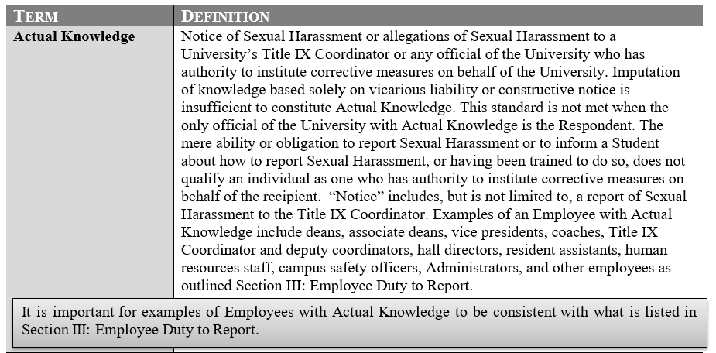
Actual Knowledge

Slide 62
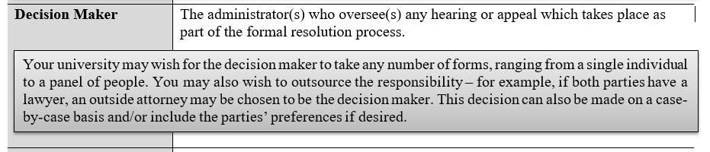
Decision Maker

Slide 63
Consent
The final regulations do not require a definition of consent. As such, your university’s final policy would still be compliant with Title IX if it wishes to have a more or less conservative definition of the term then this, or omit the definition altogether.

Slide 64
I. SCOPE
Remember:
This policy covers sexual harassment in any medium that occurs in a University’s educational program or activity and in some off campus situations. The University has a duty to respond when they have actual knowledge of a violation.

Slide 65
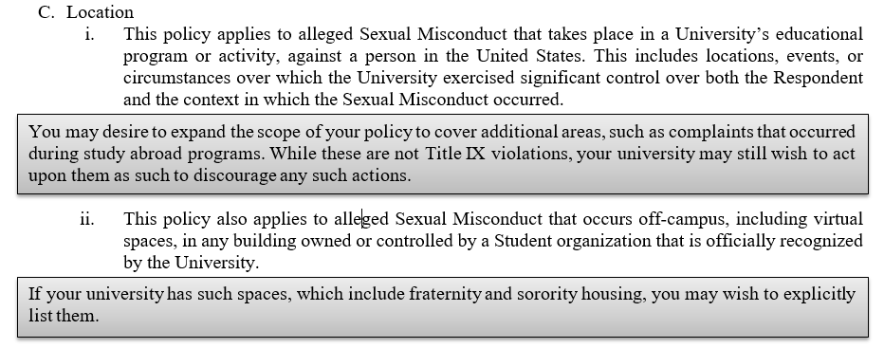
I. SCOPE

Slide 66
III. EMPLOYEES WITH AUTHORITY TO INSTITUTE CORRECTIVE MEASURES
Under the new regulations, the University’s duty under Title IX is triggered when it has Actual Knowledge of an alleged violation. Actual Knowledge is assumed when the Title IX Coordinator or any official of the University who has authority to institute corrective measures on behalf of the University is made aware of an allegation. It is left up to the University to define which individuals have such authority. In order to limit liability to the University, it is recommended to keep this list narrowed to specific individuals.

Slide 67
III. EMPLOYEES WITH AUTHORITY TO INSTITUTE CORRECTIVE MEASURES
Who could you include?

Slide 68
III. EMPLOYEES WITH AUTHORITY TO INSTITUTE CORRECTIVE MEASURES
Who could you include?
Who should you include?

Slide 69
IV. EMPLOYEE DUTY TO REPORT
Under the new regulations, employees who do NOT have authority to issue corrective action are not required to report their knowledge of alleged sexual harassment to anyone. Prior policies often contained detailed mandatory reporting provisions. If the University is interested in keeping a broad mandatory reporting requirement, consider including the provisions below, which are largely based on the prior guidance. This should be adjusted to fit the University’s views on this issue.

Slide 70
IV. EMPLOYEE DUTY TO REPORT
Who could you include?

Slide 71
IV. EMPLOYEE DUTY TO REPORT
Who could you include?
Who should you include?

Slide 72
IV. EMPLOYEE DUTY TO REPORT
Who could you include?
Who should you include?
Should anyone be exempt?

Slide 73
V. REPORTING ALLEGATIONS OF SEXUAL HARASSMENT
Key Points:
Anyone may report
Filing a report with law enforcement is NOT a prerequisite for reporting to the University and vice versa – a student has the right to do one and not the other
What is the difference between a “report”
and a “Formal Complaint?”

Slide 74
VI. CONFIDENTIALITY AND PRIVACY
Key Points:
Complainants have a right to privacy and can request that no formal investigation or disciplinary action follow
BUT the University can decide to proceed anyways on a case-by-case basis
  At that point the Complainant has no obligation to proceed as part of the investigation
How confidential are witnesses’ identities?

Slide 75
VIII. INVESTIGATION AND RESOLUTION OPTIONS
After an initial review by the Title IX Coordinator, either informal or investigative resolution can be pursued.

Slide 76
IX. REMEDIES
When the University makes a finding of a policy violation, it will take steps, whether individual or systemic, to stop the alleged Sexual Harassment, prevent its recurrence, and remedy the discriminatory effects on the Complainant and others, as appropriate

Slide 77
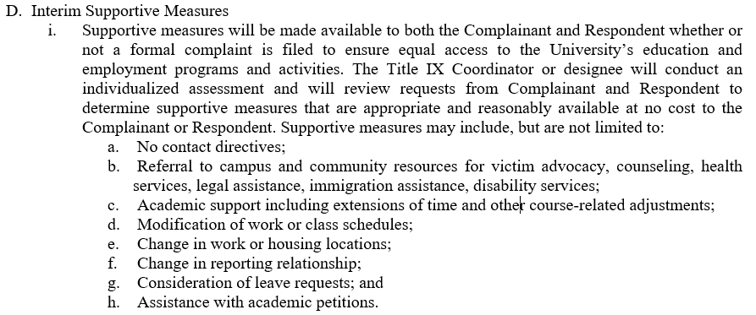
Supportive Measures

Slide 78
X. FALSE ALLEGATIONS
Key Points:
False allegations must be made in BAD FAITH to be a violation
The absence of a finding of a policy violation is not equivalent to finding that the Complainant acted in bad faith

Slide 79
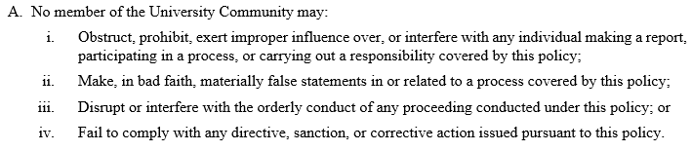
XI. PROCESS ABUSE

Slide 80
XII. TRAINING
Annual University-wide Sexual Harassment training as outlined in Section XII is not mandated by the regulations – use discretion.

Slide 81
XII. TRAINING
Annual University-wide Sexual Harassment training as outlined in Section XII is not mandated by the regulations – use discretion.

Slide 82
Model policy: procedure

Slide 83
I. INITIAL ASSESSMENT
Key Points:
Notify complainant of availability of supportive measures, right to file a formal complaint, and the process for doing so
Title IX Coordinator needs to review and determine available options for resolution
Notice to respondent if formal complaint is filed – specific requirements including presumption of innocence and right to an advisor

Slide 84
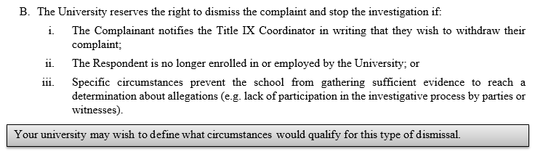
II. DISMISSAL OF A COMPLAINT

Slide 85
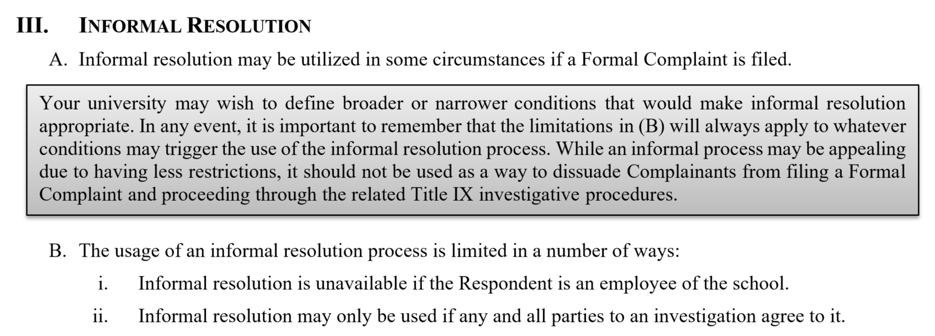
III. INFORMAL RESOLUTION

Slide 86
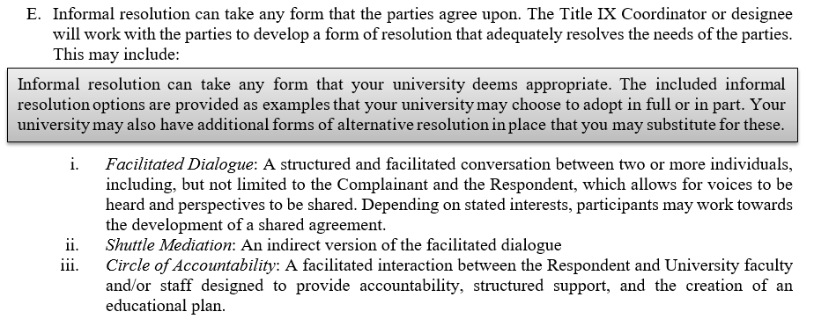
III. INFORMAL RESOLUTION

Slide 87
IV. FORMAL RESOLUTION & HEARINGS
Investigation Key Points:
Meet with parties separately and collect information & evidence
Neither the complainant nor respondent are required to participate in the investigation process
Parties have an equitable right to:
  Notice, a prompt process, equal access, advisors, and trained investigators without conflict or bias
Investigative report cannot be finalized until all evidence is shared with the parties
Investigative report to be circulated to both parties upon completion

Slide 88
IV. FORMAL RESOLUTION & HEARINGS
Hearing Key Points:
  Requirement of live hearings
  Form of Decision Maker – single person/panel/other
  Role of Advisors
  Questioning by Decision Maker and cross-examination by Advisors
  Use of technology for parties in separate rooms
  Recording

Slide 89
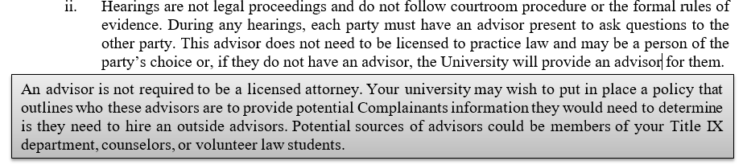
Hearings

Slide 90
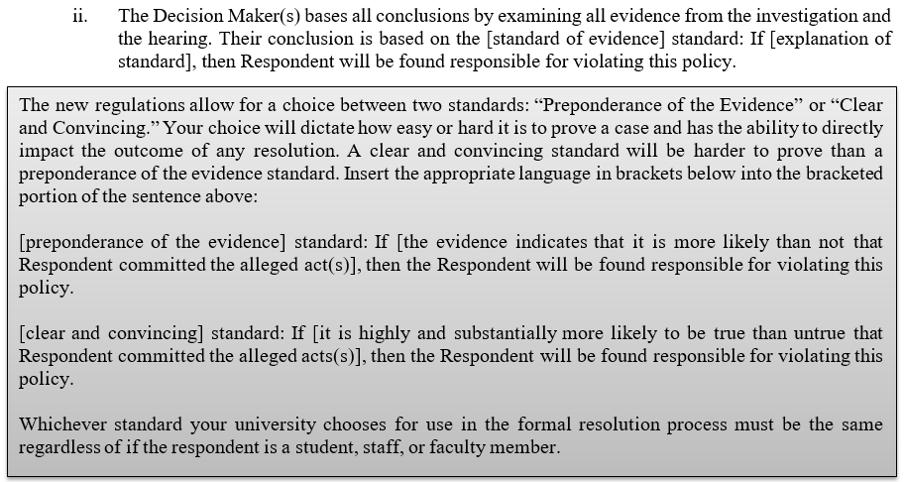
Resolution

Slide 91
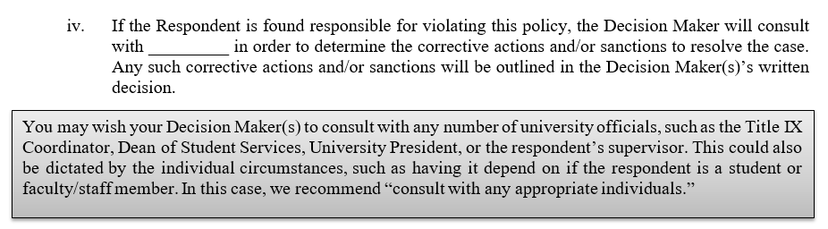
Resolution

Slide 92
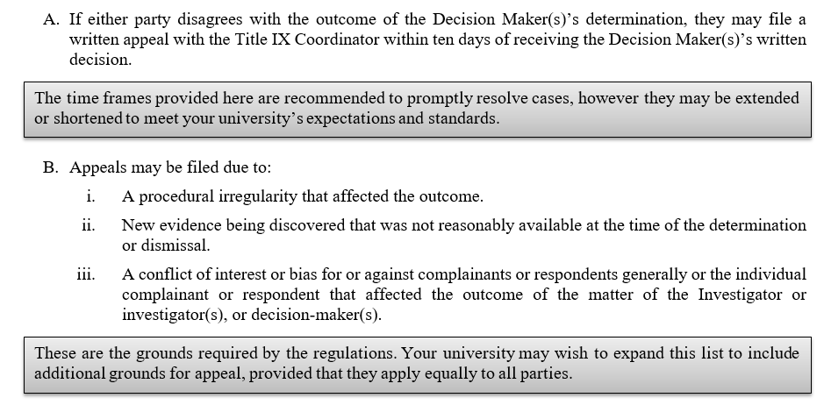
V. APPEALS PROCESS

Slide 93
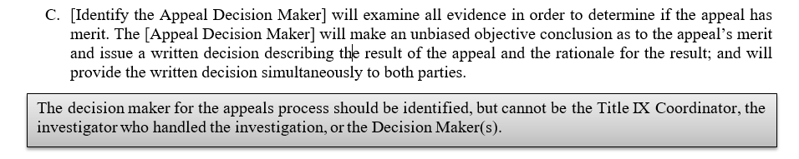
V. APPEALS PROCESS

Slide 94
Part II: Investigations

Slide 95
investigations
Presented by Mark Scudder

Slide 96
Big Picture Items
Both the investigation and hearing processes have gone through significant changes as a consequence of the regulations
Cannot be discriminatory on the basis of sex and must apply to complainants and respondents

Slide 97
Roles Within School’s Title IX Department
Single investigator model is no longer allowed
  Investigators and Decision Maker(s) cannot be the same in any given case
All individuals in the case must be unbiased
This is one area that could result in requiring additional staff!

Slide 98

Does this situation cause bias?
A member of the Title IX department shares the following image on their personal social media page:

Slide 99
Timeline
Conduct the investigation
  Interview witnesses, gather evidence, etc.
Produce the evidence to both sides
Finalize the report
Conduct a hearing

Slide 100
Investigation Overview
Coordinate with law enforcement as needed
  Never force or discourage a complainant go to the police
Gather as much evidence as possible
  Texts, e-mails, pictures, etc.
Strategically schedule interviews
  But surprise interviews are now barred
Conduct an exhaustive and complete investigation

Slide 101
Evidence Gathering
Equal opportunities for both parties to have witnesses
Can’t restrict parties from discussing allegations or presenting evidence
Access to have other people present, including advisors or attorneys
Must provide written notice to all parties of date, time, location, participants, and purpose of all hearings, interviews, and other meetings with sufficient time for the party to prepare
Equal opportunities for parties to inspect and review evidence obtained and a opportunity to respond to evidence

Slide 102
Interview Basics
Typical strategy for witness interviews:
  Put the witness at ease
  Explain the procedure and situation
  Let the witness give a narrative
  Ask questions based on the narrative as well as questions that may be outside the narrative
Consider whether a specific interview requires a different approach

Slide 103
Putting the Witness at Ease (or Not)
Private location
Comfortable
Avoid displays of power
  “Scary” office
  Sitting across desk
  High chair, etc.
Have a note-taker so the interviewer can just have a conversation
Notes:
Optional

Slide 104
Explain the Procedure
Set the tone for the interview
Review the policy as necessary
  Be clear about confidentiality
  Explain what steps have been taken
  Remind them of anti-retaliation provisions
After the interview, explain the next steps
Notes:
Optional

Slide 105
Questioning
The goal is an open-ended conversation
The narrative – Just let the witness talk
  Fill in the gaps and get specifics
Questions outside the narrative are particularly helpful for third party witnesses
Be non-judgmental
Get more information than you give
Listen carefully for witnesses and tangible evidence that would be helpful for the investigation
Notes:
Optional

Slide 106
Let’s watch a few interview interactions…
These first three videos feature the complainant in an investigation, Sophia.
Keep an eye out for the good, the bad, and the ugly.

Slide 107
Investigator Interview with Complainant

Slide 108

What are your thoughts?
Type your observations in the chat or unmute yourself and share!

Slide 109
Investigator Interview with Complainant

Slide 110
What are your thoughts?
Type your observations in the chat or unmute yourself and share!

Slide 111
Investigator Interview with Complainant

Slide 112
What are your thoughts?
Type your observations in the chat or unmute yourself and share!

Slide 113
Let’s watch a few interview interactions…
Last up is one final interview featuring a friend of the complainant, Olivia.
Any problems that you notice?

Slide 114
Investigator Interview with Witness

Slide 115
What are your thoughts?
Type your observations in the chat or unmute yourself and share!

Slide 116
Production of All Evidence to Both Parties
Universities are required to produce all evidence directly related to the allegations to both sides
The parties get ten days to respond to this evidence before the investigative report can be finalized
What does this mean for the identity of any witnesses?

Slide 117
Investigative Report - Requirements
Universities must prepare investigative report on the allegations of the formal complaint
Must provide ten days after finalizing to circulate before hearing and determination of responsibility

Slide 118
LUNCH BREAK

Slide 119

EVIDENTIARY ISSUES
Presented by Chris Bayh

Slide 120
Two opportunities for parties to weigh in
Opportunity 1: The Evidence
§ 106.45(b)(5)(vi):
Equal opportunity to inspect and review any evidence obtained as part of the investigation that is directly related to the allegations raised in a formal complaint
  including the evidence upon which the recipient does not intend to rely in reaching a determination
  inculpatory or exculpatory evidence whether obtained from a party or other source
Send to advisors
Provide both sides at least 10 days to submit a written response
Consider those in completing the investigative report

Slide 121
Two opportunities for parties to weigh in
Opportunity 2: The Report
§ 106.45(b)(5)(vii):
Create an investigative report that fairly summarizes relevant evidence
At least 10 days prior to the hearing, send to each party and the party's advisor the investigative report
Provide 10 days for their review and written response

Slide 122

Common Pitfalls

Slide 123
Bias & Evidentiary Issues – Key Points
Dispassionate, plain statement of the relevant facts
Key: the “relevant facts”
Framework: chronological, reporting side, responding side
If evidence is missing, explain why
No credibility judgments
Avoid opinions or conclusions
Avoid words that subtly signal opinions or conclusions
  Adjectives and adverbs – just the facts!
  “However”

Slide 124
Relevance & Cross-Examination
All evidence must be “relevant”
Looking ahead, any admitted “statement” must be subject to cross-examination

Slide 125
Relevance – how defined?
“The final regulations do not define relevance, and the ordinary meaning of the word should be understood and applied.” Cmts. p. 811, fn 1018.
A school “may not adopt a rule excluding relevant evidence because such relevant evidence may be unduly prejudicial, concern prior bad acts, or constitute character evidence.” Cmt. p. 812.

Slide 126
Relevance – any specifics?
A few – § 106.45(b)(6)(i):
  Irrelevant: “the complainant’s sexual predisposition or prior sexual behavior”
    Think: rape shield laws
  Exceptions—where prior sexual behavior may be relevant:
    Assailant identity: “to prove that someone other than the respondent committed the conduct alleged”
    Prior complainant-respondent relations: evidence “concern[ing] specific incidents of the complainant’s prior sexual behavior with respect to the respondent and are offered to prove consent”

Slide 127
Relevance – making the call
What if we get a relevance call wrong?
  Chance to reexamine it: “if a party disagrees with an investigator’s determination about relevance, the party can make that argument in the party’s written response to the investigative report under § 106.45(b)(5)(vii).”
This may suggest erring on the side of inclusion… or not.
  Impact of changing the call
  How to responsibly include close-call evidence, if you choose to do it

Slide 128
Cross-Examination: how it bears on investigation
Conduct your investigation with an eye toward the requirement of cross-examination.
To be admitted, any “statement” must be subject to cross-examination.
“Statement” is broad.
  It “has its ordinary meaning.”
  It “would not include evidence (such as videos) that do not constitute a person’s intent to make factual assertions, or to the extent that such evidence does not contain a person’s statements.”
  Includes “police reports, SANE reports, medical reports, and other documents and records… to the extent that they contain the statements of a party or witness.”
Who makes the statement is important.

Slide 129
Hearsay – what about that?
“the proposed rules do not speak to admissibility of hearsay”
However, § 106.45(b)(6)(i) “states that the decision-maker must not rely on the statement of a party or witness who does not submit to cross-examination, resulting in exclusion of statements that remain untested by cross-examination” Cmt. p. 811 & fn. 1017.

Slide 130
Let’s take a look at our investigative file…
Relevant or not?
In our investigation, two interviewees—both of whom are Complainant’s sorority sisters—stated that Complainant has had many sexual partners, including one-night stands with men she has met on the same night of their encounters.

Slide 131
Let’s take a look at our investigative file…
Relevant or not?
Pictures from the night in question show Complainant at a bar with her friends. It was Halloween, and complainant is pictured wearing a very revealing costume. In our investigation, one of her friends who was out with her that night stated that Complainant referred to her costume as “sexy superhero.”

Slide 132
Let’s take a look at our investigative file…
Relevant or not?
We spoke to both Complainant and Respondent. They both agree that they have had consensual sex on two prior occasions. Complainant says that this latest encounter was not consensual; Respondent says that it was.

Slide 133
Let’s take a look at our investigative file…
Relevant or not?
Investigation shows that Respondent used campus computers to access and view pornographic videos on two occasions.

Slide 134
Let’s take a look at our investigative file…
Relevant or not?
Two interviewees stated:
They have heard rumors that Respondent has behaved in a sexually inappropriate way with women before, with no specifics;
Respondent is generally thought of as a “creep.”

Slide 135
Let’s take a look at our investigative file…
Relevant or not?
In the investigation, we interviewed Jennifer, a friend of the Complainant. Jennifer stated that her old roommate, Elizabeth, once confided in Jennifer that the Respondent had sex with her while she was unconscious during freshman orientation two years ago. Elizabeth never filed a Title IX complaint, never contacted law enforcement, and never told anyone else about the incident.

Slide 136
Let’s take a look at our investigative file…
Relevant or not?
One of Complainant’s friends stated that Complainant has a reputation for lying and exaggerating. The friend offered two examples.

Slide 137
Let’s take a look at our investigative file…
Relevant or not?
Respondent has some criminal history. Last year, he was arrested and charged with public intoxication and underage consumption when police found him staggering home alone late one night. He paid a fine and the charge was expunged. The year before, he was charged with credit card fraud. He pleaded to a Class A misdemeanor and received probation and a fine.

Slide 138
Importance of the Investigative Report
Foundation for the hearing
Pre-hearing opportunity for Complainant and Respondent to “litigate” what, exactly, are the facts and what facts should come into evidence at the hearing
Laying ground for eventual appeal

Slide 139
THE INVESTIGATIVE REPORT
Presented by Mark Scudder

Slide 140

Writing a Strong Investigative Report

Slide 141
Writing a Strong Investigative Report
It’s important to connect ALL of the dots in order to paint a complete picture that fully supports any future conclusions.
Keep an eye out for gaps or missing connections in order to produce the strongest investigative report possible.

Slide 142
Writing a Strong Investigative Report
Remember:
  Don’t forget to outline the procedural steps that have been followed
  Paint the complete picture with relevant, unbiased evidence
  Write from a point of neutrality
    Avoid any implications of bias or conflicts
  Look to the template as a starting point

Slide 143
Questions & discussion

Slide 144
Part III: Hearings,
Determinations, & Appeals

Slide 145
Discussion Topics:
Hearing Procedures
Mock Hearing Scenarios and Evidentiary Issues
  Review of the Investigation Report
  Planning the Hearing
  Evidentiary Issues
Final Determinations and Appeals
Key Takeaways

Slide 146
Hearing Procedures
Presented by Mark Scudder

Slide 147
Hearings Topics
Big Picture Items
Roles Within School’s Title IX Department
Hearings
Advisors & Cross-Examinations

Slide 148
Big Picture Items
Both the investigation and hearing processes have gone through significant changes as a consequence of the regulations
Cannot be discriminatory on the basis of sex and must apply to complainants and respondents

Slide 149
Roles Within School’s Title IX Department
Single investigator model is no longer allowed
  Investigators and Decision Maker(s) cannot be the same in any given case
All individuals in the case must be unbiased
This is one area that could result in requiring additional staff!

Slide 150
Hearings
Hearings are now mandatory for all post-secondary schools
Must be conducted live with both parties able to simultaneously see and hear each other
  If requested by either party, the hearing can be conducted in separate rooms with technology to enable this requirement
  Can also be done virtually

Slide 151
Hearings
Recordings of the hearings must be available for all parties to inspect and review
  Audio
  Audiovisual
  Transcript

Slide 152
Hearing Procedure
Opening statements?
Order of witnesses?
Questions from the hearing officer?
Closing statements?

Slide 153
Advisors & Cross-Examinations
Cross-examinations are now allowed by regulation
Parties can not directly cross-examine each other
  Questions must be asked by a party’s advisor or attorney
Schools must provide an advisor for the purpose of cross-examinations if parties do not have one
  Does not have to be a lawyer
This is another area that may result in requiring additional staff!

Slide 154
Advisors & Cross-Examinations
Questions must be relevant before the party or witness provides an answer
Relevance is not defined within the regulations
Questions regarding prior sexual history are only allowed when:
  Such information is offered to prove someone other than the respondent committed the sexual harassment, or:
  Prior sexual behavior between the parties offered as proof that there was consent

Slide 155
Limitations on Advisor’s Role
Advisors must be allowed to cross-examine and question witnesses
Any other restrictions are allowed, but must be applied equally to all parties

Slide 156
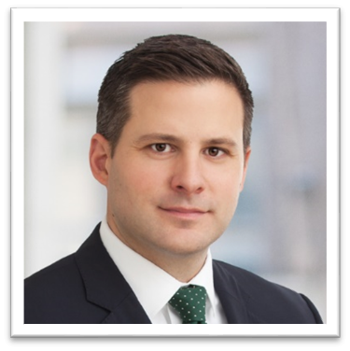

Mock HEARING scenarios / evidentiary issues

Slide 157
Scenario
Scenario to illustrate some key concepts

Slide 158
Starting the Hearing
Proceedings must be equitable and governed by consistent procedures
Opening statements discretionary
  Time limit?
  Party versus advisor?
  Excluded entirely?

Slide 159
Direct Examination of Complainant (Sophia)

Slide 160
Key Issues We Tackled
General process
Opportunity to be heard
Relevance
Leading questions
Training, competence

Slide 161
Cross Examination of Complainant (Sophia)

Slide 162
Key Issues We Tackled
Relevance
Sexual history & predisposition
Mistaken identity
Intoxication
Badgering the witness

Slide 163
Relevance – how defined?
“The final regulations do not define relevance, and the ordinary meaning of the word should be understood and applied.” Cmt. p. 811, fn 1018.
Something that has a tendency to make a consequential fact more or less probable than it would be without the evidence.
A school “may not adopt a rule excluding relevant evidence because such relevant evidence may be unduly prejudicial, concern prior bad acts, or constitute character evidence.” Cmt. p. 812.

Slide 164
Relevance – any specifics?
A few – § 106.45(b)(6)(i):
  Irrelevant: “the complainant’s sexual predisposition or prior sexual behavior”
    Think: rape shield laws
  Exceptions—where prior sexual behavior may be relevant:
    Assailant identity: “to prove that someone other than the respondent committed the conduct alleged”
    Prior complainant-respondent relations: evidence “concern[ing] specific incidents of the complainant’s prior sexual behavior with respect to the respondent and are offered to prove consent”

Slide 165
Relevance – making the call
Chance to address it from the investigation report.
  “[I]f a party disagrees with an investigator’s determination about relevance, the party can make that argument in the party’s written response to the investigative report under § 106.45(b)(5)(vii).”
Chance to address it during or even after the hearing.

Slide 166
Absent Witnesses

Slide 167
Key Issues We Tackled
Opportunity to be heard
Relevance
Cross-examination of “statements”

Slide 168
Cross-Examination
To be admitted, any “statement” must be subject to cross-examination.
“Statement” is broad.
  It “has its ordinary meaning.”
  It “would not include evidence (such as videos) that do not constitute a person’s intent to make factual assertions, or to the extent that such evidence does not contain a person’s statements.”
  Includes “police reports, SANE reports, medical reports, and other documents and records… to the extent that they contain the statements of a party or witness.”
Who makes the statement is important.
  Rule is limited to cross-examination.

Slide 169
Cross-Examination – trouble spots
Where concerns tend to show up:
  Formal reports: police, SANE, medical, other investigations
  Emails and text messages
  Hearsay—“I heard…”; “he told me…”; etc.
Is it really cross-examination? Look out for:
  Which side is offering the statement into evidence? It’s the other side that must have the chance to ask the speaker about it.
  Think: whether the person who made the statement may wish to avoid that statement by refusing to testify.

Slide 170
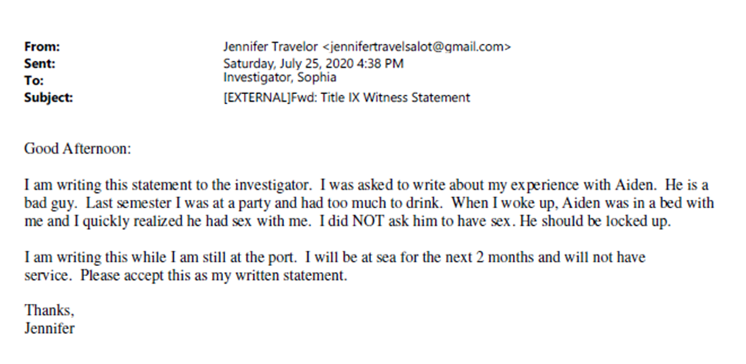
Deciding what evidence can be part of the record
Admissible or not?

Slide 171
Hearsay – what about that?
“the proposed rules do not speak to admissibility of hearsay”
However, § 106.45(b)(6)(i) “states that the decision-maker must not rely on the statement of a party or witness who does not submit to cross-examination, resulting in exclusion of statements that remain untested by cross-examination” Cmts. p. 811 & fn. 1017.
Think:
  Is an affirmative statement of fact being left unchallenged?
  Or is the original speaker the complainant or respondent?

Slide 172
Direct Examination of Aiden

Slide 173
Key Issues We Tackled
Relevance

Slide 174
Cross Examination of Aiden

Slide 175
Key Issues We Tackled
Opportunity to be heard
Relevance
Cross-examination

Slide 176
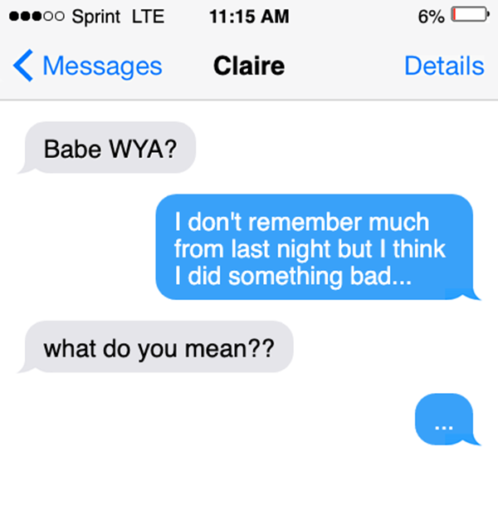
Deciding what evidence can be part of the record
Relevant or not?
Complainant wishes to rely on a text message that the Respondent sent to a friend the day after the events in question. The text reads, “I don’t remember much from last night but I think I did something bad.” Respondent refuses to testify.

Slide 177
Refusal to Answer Questions
§ 106.45(b)(6)(i)
  “If a party or witness does not submit to cross-examination at the live hearing, the decision-maker(s) must not rely on any statement of that party or witness in reaching a determination regarding responsibility;”
  “provided, however, that the decision-maker(s) cannot draw an inference about the determination regarding responsibility based solely on a party's or witness's absence from the live hearing or refusal to answer cross-examination or other questions.”

Slide 178
Final determinations & appeals
Presented by Mark Scudder

Slide 179
What happens after the final determination is made?
After the hearing has been concluded and a final determination has been made, the decision-maker prepares the written determination.

Slide 180
Evidentiary Standard
The new Rule provides the choices between 2 standards:
  the preponderance of the evidence standard; or
  the higher clear and convincing evidence standard.
What’s the difference?

Slide 181
What are your thoughts?
Would Aiden be found to be responsible under a PREPONDERANCE OF THE EVIDENCE standard?

Slide 182
What are your thoughts?
Would Aiden be found to be responsible under a CLEAR AND CONVINCING EVIDENCE standard?

Slide 183
What must be included?
Identification of the allegations
Description of the procedural steps taken from the receipt of the formal complaint through the determination
  Must include:
    Any notifications to the parties
    Interviews with parties and witnesses
    Site visits
    Methods used to gather evidence
    Hearings held

Slide 184
What must be included?
Findings of fact supporting the determination;
Conclusions regarding the application of the Code of Conduct to the facts;
A statement of, and rationale for, the result as to each allegation, including a determination regarding responsibility;
Any disciplinary sanctions imposed;
Any remedies provided to the Complainant;

Slide 185
What must be included?
Procedures and permissible bases for an appeal (available to both parties)
The written determination must be provided to the parties simultaneously.

Slide 186
When does the written determination become final?
Either the date on which an appeal would no longer be considered timely; OR
On the date that the parties are provided the written determination of the result of the appeal.

Slide 187
Appeal Process
Both parties must be offered an appeal from a determination regarding responsibility or from a dismissal of a formal complaint or any allegations therein.

Slide 188
Basis for Appeals
Procedural irregularity that affected the outcome of the matter;
New evidence that was not reasonably available at the time the determination regarding responsibility or dismissal was made, that could affect the outcome of the matter;
The Title IX Coordinator, investigator(s), or decision-maker(s) had a conflict of interest or bias for or against complainants or respondents generally or the individual complainant or respondent that affected the outcome of the matter.

Slide 189
Appeal Procedure (mandatory)
Notify the other party in writing when an appeal is filed;
Implement appeal procedures equally for both parties;
Ensure that the decision-maker(s) for the appeal is not the same person as the decision-maker(s) that reached the determination regarding responsibility or dismissal, the investigator(s), or the Title IX Coordinator
Give both parties a reasonable, equal opportunity to submit a written statement in support of, or challenging, the outcome;
Issue a written decision describing the result of the appeal and the rationale for the result; and
Provide the written decision simultaneously to both parties.

Slide 190
Record Retention
The following must be retained on file for seven years:
Records of investigation
Records of appeals and associated materials
Records of any informal resolution process
All materials used to train Title IX staff and any person who facilitates an informal resolution
Records of supportive measures taken in response to a complaint

Slide 191
Key Takeaways
  There have been significant changes in both the investigation and hearing processes as a result of the new regulations.
  Hearings are now mandatory.
    Both parties must have an advisor for cross-examination
  Relevance is key!
  Develop a final determination report that both adequately supports the determination of the decision maker and covers your bases for potential future appeals.

Slide 192
Record Retention
The following must be retained on file for seven years:
Records of investigation
Records of appeals and associated materials
Records of any informal resolution process
All materials used to train Title IX staff and any person who facilitates an informal resolution
Records of supportive measures taken in response to a complaint

Slide 193
QUESTIONS?
Ask aloud or submit through the chat window!

Slide 194
Thank You For Attending!

